Slide 1

Look at the screen and answer the questions

Slide 2
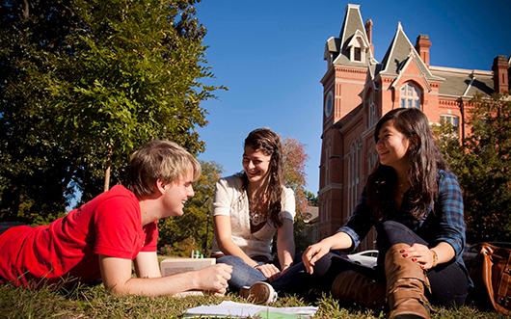
University life in Great Britain
Our aim:
to learn how to talk about life at universities in Great Britain

Slide 3
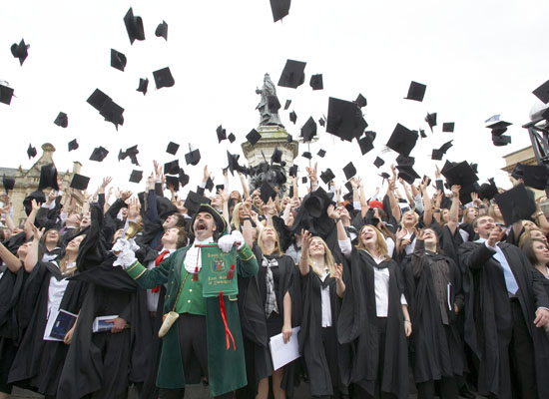

Ex.2, p. 131
Answer Key
1. Matthew Springer
2. Sylvie LeGrange, Steven Howard
3. Sarah Miles
4. Sarah Miles
5. Steven Howard

Slide 4
Ex.3, p. 131
Answer Key
Underlined words | Their meanings
scraping by | Managing to live with very little money
meager | Very small
get carried away | Be over-enthusiastic
one-on-one | Involving only two people
interactive | Allowing communication
gown | Loose formal robe
going on | Happening

Slide 5
Ex.3, p. 131
Answer Key
Underlined words | Their meanings | Their definitions (Cambridge Dictionary)
scraping by | Managing to live with very little money | having only enough money to pay for the basic things you need
meager | Very small | very small in amount or number; only as much or not as much as is needed or thought to be suitable
get carried away | Be over-enthusiastic | become so excited about something that you do not control what you say or do
one-on-one | Involving only two people | this activity involves two people talking directly, usually with one teaching or giving information to the other
interactive | Allowing communication | involving communication between people
gown | Loose formal robe | a long, loose piece of clothing worn over other clothes for a particular purpose
going on | Happening | happening

Slide 6
Ex.4, p. 131
Answer Key
places | Campus, Student Union, library, college dining hall
lessons | lectures, essay deadlines, private research, seminars, tutorial
accommodation | halls, student house
teachers | tutor
after-school activities | university newspaper, drama club, canoeing club, parties, concerts, hanging out, formal dinners, social life, band, theme night

